Slide 2
Module 7: Advanced SQL Day 1

Slide 3
Agenda 27.10.2022
from | to | topic
9:00 | 9:15 | Introduction
9:15 | 12:30 | Self Study Block
~10:30 | ~10:45 | Coffee break
12:00 | 12:30 | Discussion Block: Self Study Session
12:30 | ~13:00 | Lunch Break
13:00 | 13:30 | Content Questions
13:30 | 16:00 | Excecise Block
16:00 | 17:00 | Discussion Block : Excercise

Slide 4
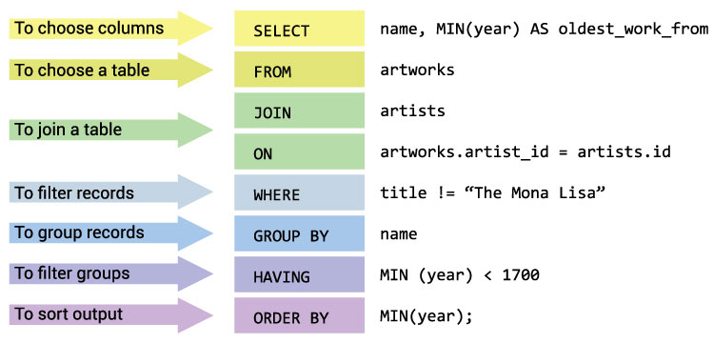
Topics for today in Brief
Overview of SQL Commands
GROUP BY: The GROUP BY clause will group records in a result set by identical values in one or more columns.
HAVING: The HAVING clause is used to further filter the result set groups provided by the GROUP BY clause.
Aggregate functions: Aggregate functions perform a calculation on a set of values and return a single value.
Yakha GmbH

Slide 5
Material
Schedule:
Watch the videos 26, 33-47, 51, 52 of the below playlist:
https://www.youtube.com/playlist?list=PL_RGaFnxSHWr_6xTfF2FrIw-NAOo3iWMy
Go through the below training material- `SQL Group By` - `SQL Operators`:
https://www.w3schools.com/sql/sql_groupby.asp
Yakha GmbH

Slide 6
Questions
Answer the below questions:
What is the difference between WHERE and HAVING?
What do you understand about a character manipulation function?
How can you fetch common records from two tables?
What is the difference between COUNT(*), COUNT(expression), and COUNT(DISTINCT expression)?
What will this code return?
Why do we need to have columns that are not part of GROUP BY Clause as part of aggregate function?
SELECT department, month,
AVG(salary) AS average_salary
FROM salaries
GROUP BY department;
Yakha GmbH

Slide 7
Exercise
In the ‘Orders’ table, write a SQL query to calculate total purchase amount of all orders. Return total purchase amount.
From the ‘Orders’ table, write a SQL query to calculate the average purchase amount of all orders. Return average purchase amount.
From the ‘Orders’ table, write a SQL query that counts the number of unique salespeople. Return number of salespeople.
From the ‘Customer’ table, write a SQL query to count the number of customers. Return number of customers.
From the ‘Customer’ table, write a SQL query to determine the number of customers who received at least one grade for their activity.
From the ‘Orders’ table, write a SQL query to find the maximum and minimum purchase amount.
From the ‘Customer’ table, write a SQL query to find the highest grade of the customers in each city. Return city, maximum grade.
Yakha GmbH

Slide 8
Exercise (Cont.)
From the ‘Orders’ table, write a SQL query to find the highest purchase amount ordered by each customer. Return customer ID, maximum purchase amount.
From the ‘Orders’ table, write a SQL query to find the highest purchase amount ordered by each customer on a particular date. Return, order date and highest purchase amount.
From the ‘Orders’ table, write a SQL query to determine the highest purchase amount made by each salesperson on '2012-08-17'. Return salesperson ID, purchase amount
From the ‘Orders’ table, write a SQL query to find the highest order (purchase) amount by each customer on a particular order date. Filter the result by highest order (purchase) amount above 2000.00. Return customer id, order date and maximum purchase amount.
From the ‘Orders’ table, write a SQL query to find the maximum order (purchase) amount in the range 2000 - 6000 (Begin and end values are included.) by combination of each customer and order date. Return customer id, order date and maximum purchase amount.
From the ‘Salesman’ table, write a SQL query to count the number of salespeople in a city. Return number of salespeople.
Yakha GmbH

Slide 9
Good luck!
Dein yakha Team

